Slide 1
They Don’t Build Them Like They Used To:
The effects of cost, quality control, and the cold war era
Felder, James
Raymond S. Kellis High School
Arizona NASA Space Grant Consortium (AZSGC)
Student Research Symposium 2024
Notes:
Alternative title: The three C’s of satellites: Cost, Quality Control, and the Cold War Era

Slide 2
Problem Statement
Satellites are man-made objects that orbit planets and send and receive information.
Why are satellites important?
Scientific studies
Symbols of success between nations
Help individuals and governments plan for weather
Space exploration
Research Question:
Why do some stay up longer than others?

Slide 3


Method: Sample
Census sampling
NASA, JPL, and EO Portal
Mission complete, non-rockets, non-resupply missions, non-demonstrations, non-commercial satellites
170 satellites total. N = 138 due to missing values.
Analysis
Descriptive statistics, coefficient of determination, ordinary least squares regression. VIF, Q-Q Plot, Shapiro-Wilk test, residual plots. Natural log and square root transformations.

Slide 4
Variables
Months Operational SQRT (Number of months a satellite was in orbit until mission complete date, square root transformation)
Day launched (Day=1, Night=0)
Used parts (Yes=1, No=0)
Climate/Weather or Space (Climate/Weather=1, Space=0)
Cold War Era (Yes=1, No=0)
Country USA any (Yes=1, No=0)
Mechanical Issues (Yes=1, No=0)

Slide 5
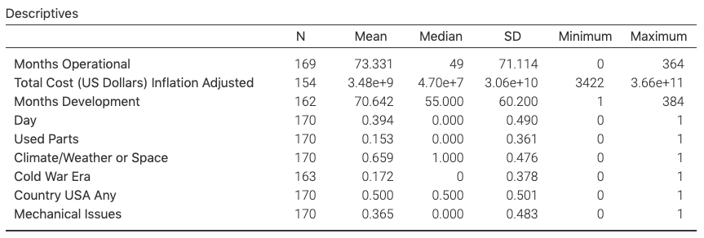
Results: Descriptive Statistics
Notes:
$3.48e+9 i.e. $3,480,000,000 (i.e. over 3 billion dollars).

Slide 6
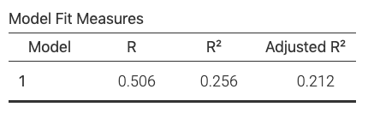
Results: Coefficient of Determination
Notes:
Show the percentage of Months Operational explained by all the variables in the following model.

Slide 7
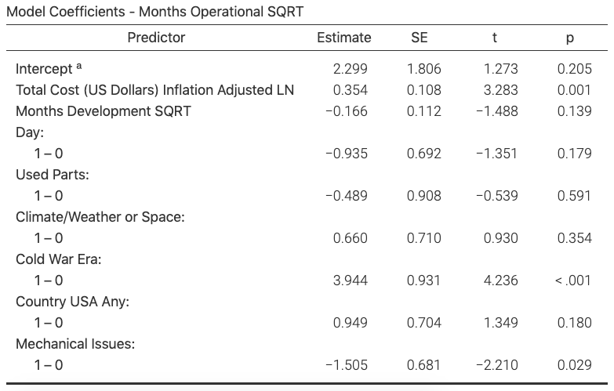
Notes:
Total Cost: Positive estimate, so increasing Total Cost increases average Months Operational.
Cold War Era: Positive estimate, average Months Operational greater during cold war era.
Mechanical issues: Negative estimate, average Months Operational less when mechanical issues.

Slide 8
Discussion: Policy Implications
Total Cost (US Dollars) Inflation Adjusted
The more expensive a satellite is the longer it is operational, but figuring out the limit of how much should be spent is for future research.
Cold War Era
We should try using the same parts as we did back then unless these parts are environmentally unsafe.
Mechanical Issues
Improve quality control and better testing of the individual parts themselves.

Slide 9
Discussion: Future Research
Improve measurement of variables
Months Development. Too crude a measure? Focus on developmental periods: planning, approval, implementation, launch preparation.
Country USA. Too crude a measure? Developing country classification.
Impute missing values in data
Interaction effects in model (e.g. mechanical issues and development)
Other measures of duration
Not as long as possible, but as long as necessary. Projected time until mission completion vs actual time.

Slide 10
They Don’t Build Them Like They Used To:
The effects of cost, quality control, and the cold war era
Felder, James
Raymond S. Kellis High School
Arizona NASA Space Grant Consortium (AZSGC)
Student Research Symposium 2024
Notes:
Alternative title: The three C’s of satellites: Cost, Quality Control, and the Cold War Era

